Slide 1
Unsupervised K-Means Clustering Algorithm
https://ieeexplore.ieee.org/stamp/stamp.jsp?tp=&arnumber=9072123
Authors:
KRISTINA P. SINAGA AND MIIN-SHEN YANG Prepared By : Manisha Vemula
Student ID: 700763276

Slide 2
Motivation
Clustering is a fundamental tool in data science for pattern recognition and machine learning.
Traditional K-means clustering requires prior knowledge of the number of clusters and is sensitive to initialization.
The need for an unsupervised approach that automatically determines the optimal number of clusters.

Slide 3
Problem Statement
The traditional K-means algorithm has limitations:
Requires a predefined number of clusters.
Sensitive to initial conditions.
May produce suboptimal clustering results.
Objective: Develop an improved K-means variant that is fully unsupervised.

Slide 4
Objectives
Propose an unsupervised K-means (U-K-means) clustering algorithm.
Eliminate the need for predefined cluster numbers.
Reduce sensitivity to initialization.
Enhance clustering accuracy and efficiency.

Slide 5
Methodology Applied/Main Idea
Introduction of an entropy-based penalty term to adjust bias.
A novel learning schema to iteratively refine clusters.
Algorithm steps:
Start with the maximum possible number of clusters.
Gradually remove redundant clusters based on entropy optimization.
Automatically determine the optimal number of clusters.

Slide 6
Results/Findings
Experiments conducted on synthetic and real-world datasets.
Comparison with other clustering methods (e.g., X-means, robust EM, RL-FCM).
Demonstrated improved accuracy and efficiency.
U-K-means effectively determined the optimal number of clusters without manual tuning.

Slide 7
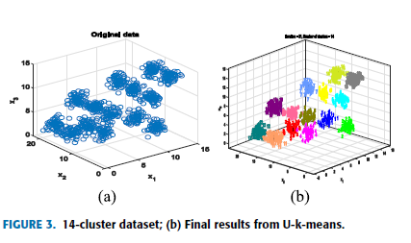
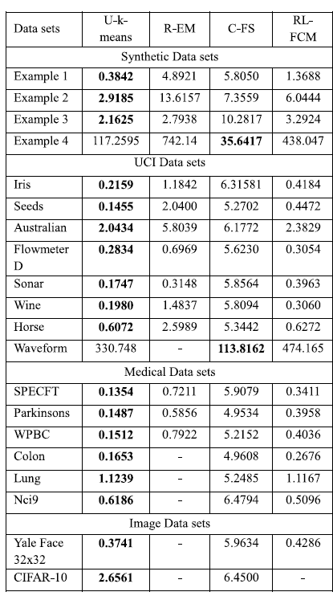
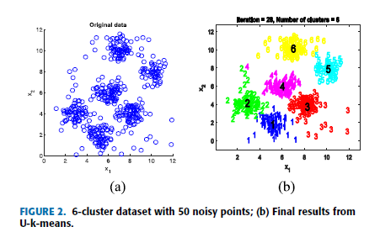
Result

Slide 8
References
[6] A. K. Jain, ``Data clustering: 50 years beyond K-means,'' Pattern Recognit. Lett., vol. 31, no. 8, pp. 651666, Jun. 2010.
[7]M.-S. Yang, S.-J. Chang-Chien, and Y. Nataliani, ``A fully-unsupervised possibilistic C-Means clustering algorithm,'' IEEE Access, vol. 6, pp. 7830878320, 2018.
[28] I. H. Witten, E. Frank, M. A. Hall and C. J. Pal, Data Mining: Practical Machine Learning Tools and Techniques. San Mateo, CA, USA: Morgan Kaufmann, 2000.
[5] J. Yu, C. Chaomurilige, and M.-S. Yang, ``On convergence and parameter selection of the EM and DA-EM algorithms for Gaussian mixtures,‘’ Pattern Recognit., vol. 77, pp. 188203, May 2018.

